Slide 1
Linking Words
Conjunctions and Connectors

Slide 2
In each pair of sentences, identify the one that is punctuated or written correctly.
(a) Access the site and click the link.
(b) Access the site, and click the link.
(a) All employees must be able to communicate effectively; therefore, we evaluate communication skills during employment interviews.
(b) All employees must be able to communicate effectively, therefore, we evaluate communication skills during employment interviews.
(a) Please let me know, when you receive the signed contract.
(b) Please let me know when you receive the signed contract.

Slide 3
(a) When you receive an e-mail attachment, be sure to check it for a virus.
(b) When you receive an e-mail attachment be sure to check it for a virus.
Sara said that Travis who works in our Marketing Department will be leaving next month.
(b) Sara said that Travis, who works in our Marketing Department, will be leaving next month.

Slide 4
Conjunctions
connecting words that can be separated into two major groups :-
that join grammatically equal words or word groups
that join grammatically unequal words or word groups

Slide 5

Types of Conjunctions
words
words
Grammatically equal value or rank
Grammatically Unequal
Value or rank
Phrases
Phrases
Subordinating conjunctions
Clauses
Clauses
Coordinating conjunctions
After, whenever, Although,
Wherever, if, ….and many more
For, And, Nor, But, Or, Yet, So

Slide 6
Coordinating Conjunctions in equal words and phrases
The qualities I admire most are honesty, integrity, and reliability. [three adjectives]
Open your mind to new challenges, and to new ideas.
Students are tired at the end of the day, but they pay attention during the lecture.

Slide 7
Using Coordinating Conjunctions
Note:-
Coordinating conjunction are used to connect compound sentences.
A compound sentence has two or more independent clauses
To join independent clauses in compound sentences, place a comma before the coordinating conjunction.

Slide 8
Sub-ordinating Conjunctions: Unequal words and phrases
Does not apply on word level
Does not apply on phrase level
Though they pay attention during the lecture, the students are usually tired at the end of the day .

Slide 9
Subordinating Conjunctions
NOTE:-
Use subordinating conjunctions to join unequal sentence elements, such as independent and dependent clauses.
Dependent clauses depend on the independent clauses for their meaning.
Dependent clauses are often introduced by subordinating conjunctions such as: if, when, because, and as.

Slide 10
Subordinating Conjunctions
Handout Pages # 15, 20, 21, 23, 24

Slide 11
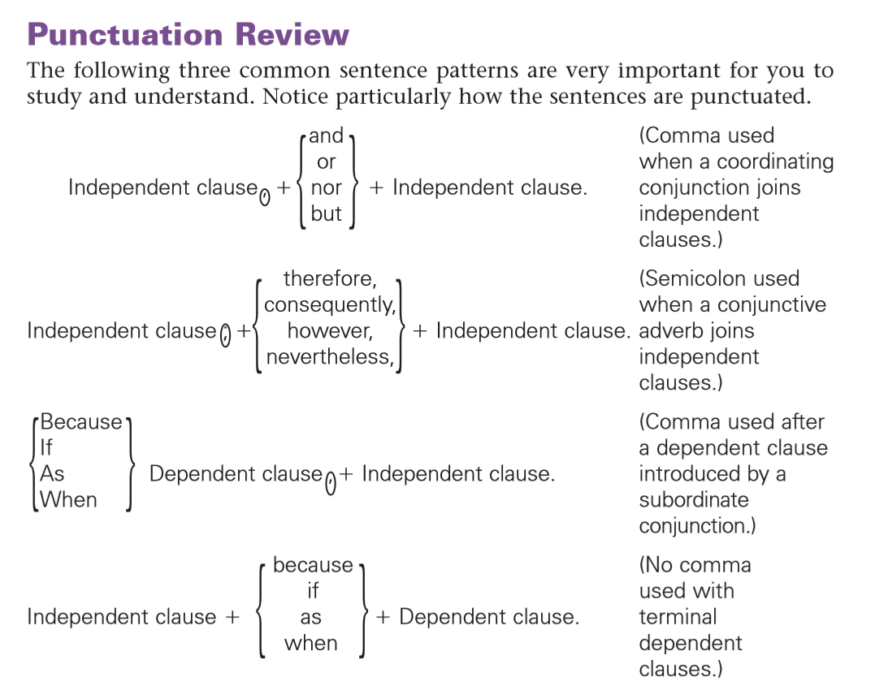
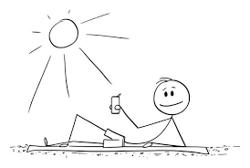
Punctuation of Sentences With Dependent Clauses

Slide 12
Rules of using Conjunctive Adverbs in Compound Sentences
Semicolons (NOT commas) are used before conjunctive adverbs that join independent clauses.
The word following a semicolon is not capitalized—unless, it is a proper noun.

Slide 13
Examples of Conjunctive Adverbs
Sarah did her best; nevertheless, she did not pass her CPA exam the first time.
Equipment expenditures are great this quarter; on the other hand, new equipment will reduce labor costs.
Some companies oppose the use of social networking; however, other companies find that it encourages team collaboration and knowledge sharing.

Slide 14
Differences b/w Connectors and Conjunctions
They have the same meaning of a conjunction but differ in their function
Conjunctions are used to connect a noun with another noun; two independent clauses; different sentences; a group of words
Connectors are used to connect a large groups of words; phrases; sentences.
What separates conjunctions and connectors from each other is the grammatical status of the two linked ideas: conjunction ones are together in the same sentence, connector ones are separate:

Slide 15
Conjunctions and Connectors
The Link is more grammatical/ structural in case of a conjunctions. In case of a connector, the link is both structural and functional.
Example
(a) CONJUNCTION: Mount Kilimanjaro is on the Equator, but it has a covering of snow.
(b) CONNECTOR : Mount Kilimanjaro is on the Equator. Nevertheless, it has a covering of snow
[Nevertheless is the beginning of a sentence in this case]

Slide 16
Connectors Corresponding to Individual Conjunctions
Most conjunctions seem to have many connectors of similar meaning
AND ← Additive
Corresponding Connectors:
additionally, also, as well , besides this, furthermore, in addition, moreover, too afterwards, next, subsequently, then, thereafter; as a result

Slide 17
Conjunction: BUT ← Contrast
Corresponding Connectors: all the same, even so, however, nevertheless, nonetheless, still, yet, by contrast, in contrast, on the other hand; on the contrary
Conjunction: so, so that (also because/since at the start) ← Cause and Effect
Corresponding Connectors: as a result, consequently, for this reason, hence, that is why, therefore, thus
SO (following “JUST AS …) ← Comparison
similarly, likewise, in a similar way, in the same way
Conjunction: OR ←
Corresponding Connectors: alternatively, if not, otherwise

